Slide 1


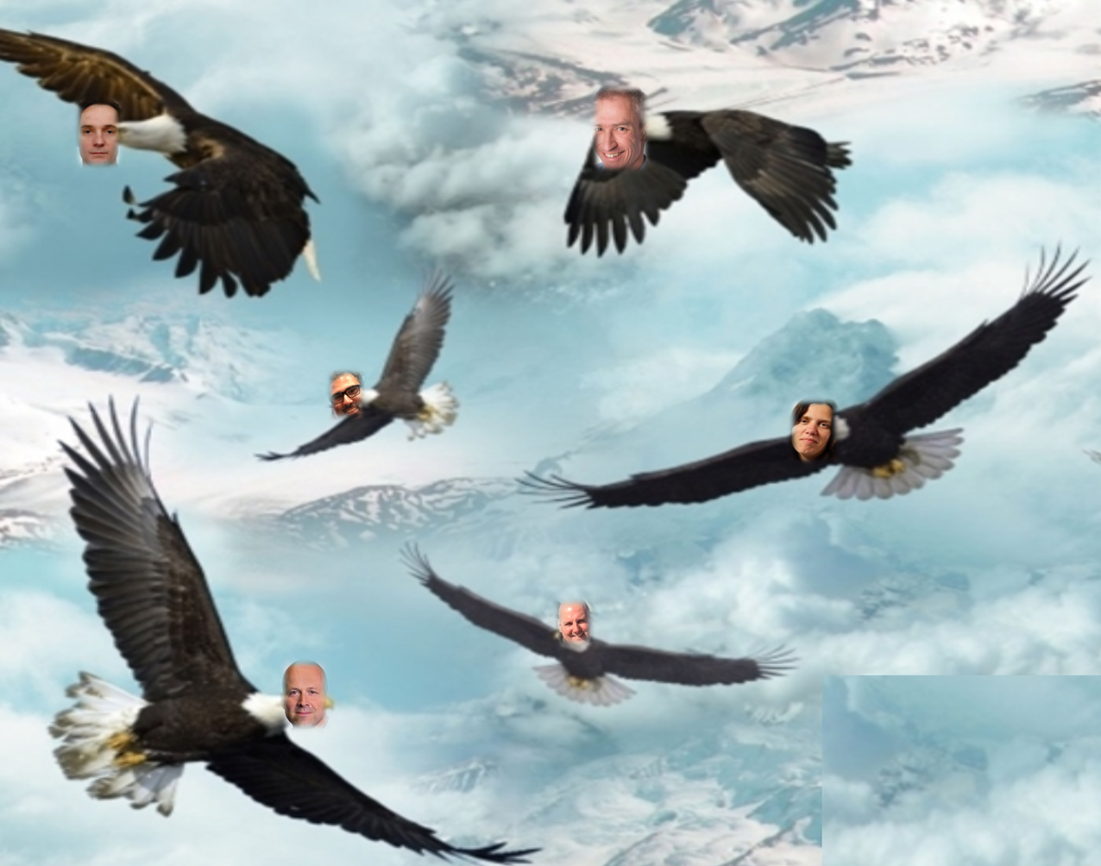
Soaring through the Clouds – Live demo of a poly-cloud microservices implementation
Exploring Oracle Cloud for Microservices
Lucas Jellema, CTO of AMIS
Oracle Groundbreakers APAC Tour
23^{srd} November 2018, Wellington, New Zealand
Notes:
Fast data arrives in real time and potentially high volume. Rapid processing, filtering and aggregation is required to ensure timely reaction and actual information in user interfaces. Doing so is a challenge, make this happen in a scalable and reliable fashion is even more interesting. This session introduces Apache Kafka as the scalable event bus that takes care of the events as they flow in and Kafka Streams and KSQL for the streaming analytics. Both Java and Node applications are demonstrated that interact with Kafka and leverage Server Sent Events and WebSocket channels to update the Web UI in real time. User activity performed by the audience in the Web UI is processed by the Kafka powered back end and results in live updates on all clients.
Fast data arrives in real time and potentially high volume. Rapid processing, filtering and aggregation is required to ensure timely reaction and actual information in user interfaces. Doing so is a challenge, make this happen in a scalable and reliable fashion is even more interesting. This session introduces Apache Kafka as the scalable event bus that takes care of the events as they flow in and Kafka Streams for the streaming analytics. Both Java and Node applications are demonstrated that interact with Kafka and leverage Server Sent Events and WebSocket channels to update the Web UI in real time. User activity performed by the audience in the Web UI is processed by the Kafka powered back end and results in live updates on all clients. Introducing the challenge: fast data, scalable and decoupled event handling, streaming analytics Introduction of Kafka demo of Producing to and consuming from Kafka in Java and Nodejs clients Intro Kafka Stream API for streaming analytics Demo streaming analytics from java client Intro of web ui: HTML 5, WebSocket channel and SSE listener Demo of Push from server to Web UI - in general End to end flow: - IFTTT picks up Tweets and pushed them to an API that hands them to Kafka Topic. - The Java application Consumes these events, performs Streaming Analytics (grouped by hashtag and author and time window) and counts them; the aggregation results are produced to Kafka - The NodeJS application consumes these aggregation results and pushes them to Web UI - The WebUI displays the selected Tweets along with the aggregation results - in the Web UI, users can LIKE and RATE the tweets; each like or rating is sent to the server and produced to Kafka; these events are processed too through Stream Analytics and result in updated Like counts and Average Rating results; these are then pushed to all clients; this means that the audience can Tweet, see the tweet appear in the web ui on their own device, rate & like and see the ratings and like count update in real time

Slide 2
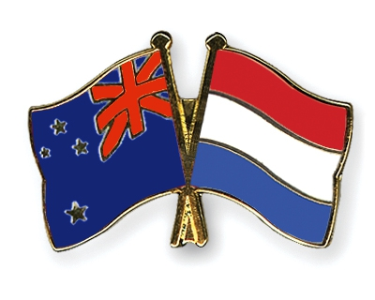

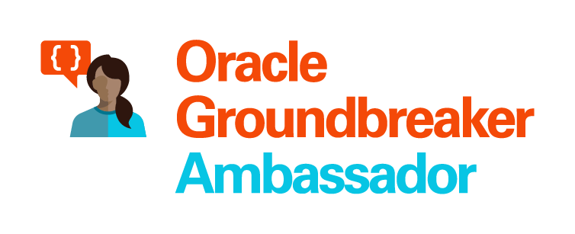


Lucas Jellema Architect / Developer 1994 started in IT at Oracle 2002 joined AMIS Currently CTO & Solution Architect

Slide 3
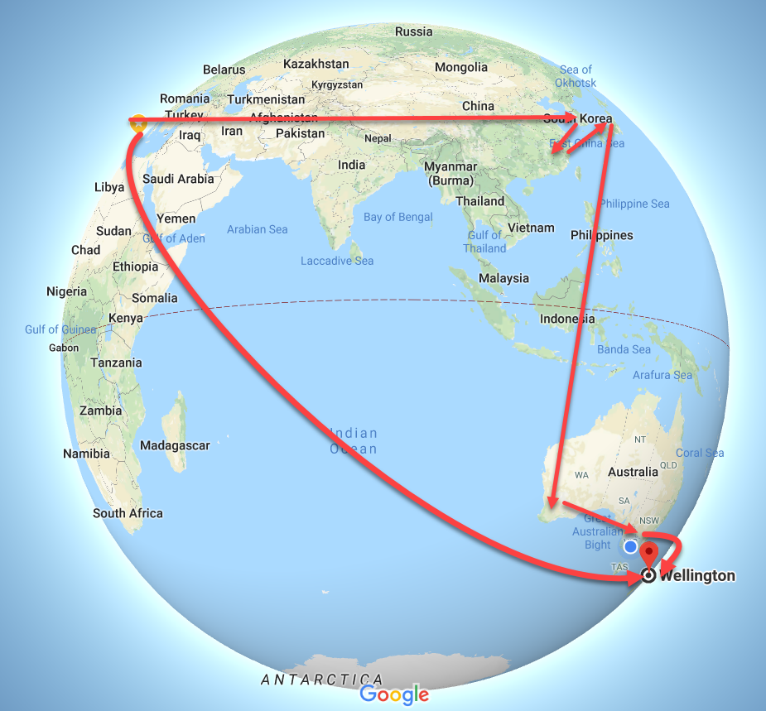
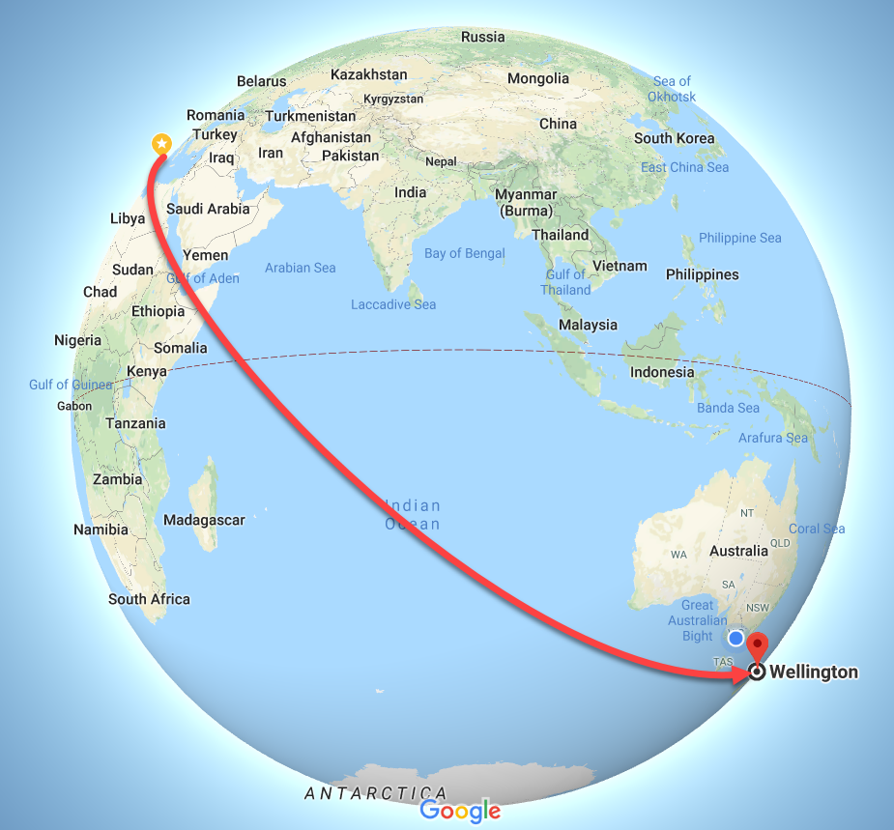
Tour of Asia & Pacific

Slide 4
Soaring through the Clouds – The Sequel Live Demo Cloud Native Microservices Architecture
Oracle Code One 2018
San Francisco, October 2018

Slide 5








Slide 6
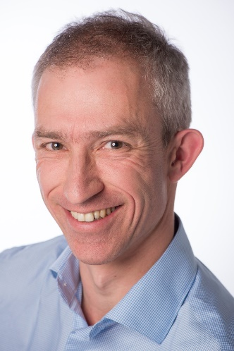
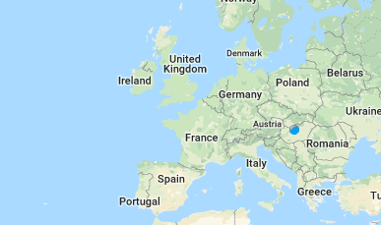




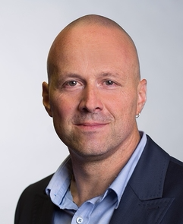
The Team

Slide 7
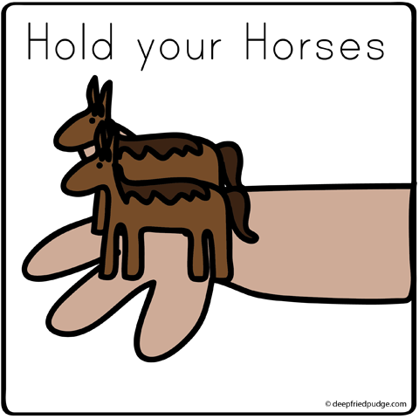
How do we implement microservices?
And how we make the containers horizontally scalable
How do we get from a Monolith to Microservices?

Slide 8
Why? What? How?
Notes:
Objectives
Requirements
Specifications

Slide 9
What is IT all about?
Production Runtime
Application

Slide 10
What is IT all about?
Production Runtime
Application
Platform

Slide 11
Objectives
Business Agility
In functionality: quick, cheap, effortless and risk free
IT Agility
In non-functionality: scale, resilience, infrastructure & location
Real working applications with rapid relevant evolution that run reliably

Slide 12
What is IT all about?
Production Runtime
Operations
Monitoring & Management
Application
Platform
Platform
Platform

Slide 13
Production Runtime is the Result of Preparation Runtime
Preparation Runtime
Production Runtime
Development
Operations
Monitoring & Management
Application
Application
Agile Design, Build, Test
Platform
Platform
CD

Slide 14
What?

Slide 15
One team has Agile responsibility through full lifecyle
Preparation Runtime
Production Runtime
Development
Operations
Monitoring & Management
Application
Application
Agile Design, Build, Test
Platform
Platform
CD

Slide 16
One team has Agile responsibility through full lifecyle
Preparation Runtime
Production Runtime
DevOps
Development
Operations
Monitoring & Management
Application
Application
Agile Design, Build, Test
Platform
Platform
CD
You build it, you run it, you fix it, you evolve

Slide 17
One team has Agile responsibility through full lifecyle
DevOps
Application
Application
Platform
Platform
You build it, you run it, you fix it, you evolve

Slide 18
DevOps team owns and runs one (or more) products
Application
Platform
Generic Infrastructure Platform for running DevOps Products
Floorspace, Power, Cooling, Storage, Compute
Monitoring, Management, Cache, Authentication, RDBMS, Event Hub

Slide 19
Multiple products from multiple teams run on a shared generic infrastructure
Application
Application
Application
Application
Application
Platform
Platform
Platform
Platform
Platform
Generic Infrastructure Platform for running DevOps Products
Floorspace, Power, Cooling, Storage, Compute
Monitoring, Management, Cache, Authentication, RDBMS, Event Hub

Slide 20
(Application plus platform)under DevOps ==
µ
µ
µ
µ
µ
Generic Infrastructure Platform for running DevOps Products
Microservice

Slide 21
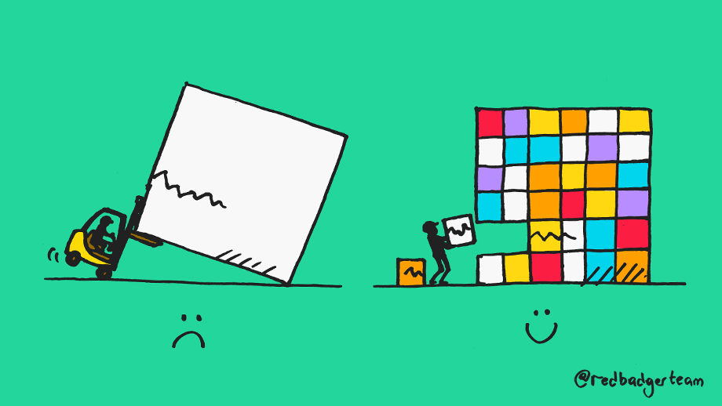
What?
Realistic approach (technology, people, process) => Something that works!
No dependency on individuals
Able to scale in rate of change
Small, well: comprehensible, manageable
Clear business ownership
Stand alone /isolated/encapsulated (in terms of change, release/deploy, scale, location, implementation technology)
Provide clear and meaningful functionality in a way that it can be consumed
One microservice does not completely fall over when other microservices break (or are redeployed)
Able to scale elastically & horizontally and relocate easily
A microservice exists within a single bounded context
Multiple microservices can share the same bounded context

Slide 22
How?

Slide 23

Final Demo
Microservices
Microservice

Slide 24
How microservices
One team owns the microservice and can do functional and technical evolution and deployment continuously and independently
The business ownership is clearly defined
Application
Platform

Slide 25
The Microservice
HTTP REST/JSON
API

Slide 26
Extended API of microservice
API
Deployment API
Injectable dependencies – reference to cache, logging, storage URL, …
Configurable meta-data – run time parameters, log level, credential (key)
Interaction API
REST Resources & Operations – query and URL parameters, message formats
Events Consumed – alternative way to call | activate a microservice
Reference to entry in Event Catalog
May include reference to shared Cache Resource
Events Produced – alternative output from microservice
Event can be an asynchronous response to a stateless consumer

Slide 27

How microservices: design & implement
Business & Team ownership of application and associated platform
Automated CD – including regression test
Open (standards, protocols) on the outside, whatever you like inside
Deployable on enterprise standardized microservices platform
API & Event
Standard protocols for interaction
Horizontally scalable: multiple parallel instances
Stateless instances – horizontally scalable up & down, can handle fail over & restart
Private Bounded (Data) Context
Including derived data from other domains

Slide 28
scale
own
test
monitor
deploy
organize
manage
scale
scale
own
test
monitor
own
test
monitor
organize
deploy
organize
deploy
manage
scale
manage
µ
own
test
monitor
organize
deploy
µ
µ
manage
µ
own
test
scale
vs.
scale
organize
deploy
monitor
own
test
monitor
µ
manage
own
test
scale
own
test
scale
organize
deploy
deploy
monitor
organize
deploy
monitor
µ
manage
organize
manage
µ
manage
µ
own
test
scale
organize
deploy
monitor
own
test
scale
µ
manage
organize
deploy
monitor
µ
manage

Slide 29
µ
µ
[mini] µonolith
µ
µ

Slide 30
Owned by Business Manager X
High Change Rate
Highly Available
Needs to scale up to 10x between 7-10PM
Can be done by team of 5
µ
µ
Owned by Business Manager Y
Business Hours availability
Some Highly Secure Data
Fairly constant load
Very strict QA steps in CI/CD process
Can be done by team of 3

Slide 31
Webshop
Web Shop Portal
Backend
Notes:
dazzle the audience with a quick dump of all technologies (and cloud services) used for putting the webshop together - for the UI, the API implementation, the datastores and the event bus.

Slide 32
Microservices based Webshop
Web Shop Portal
µ Customers
µ Orders
µ Products
µ Loyalty
µ Finance
µ Logistics
µ Customers
µ Orders
µ Products
µ Loyalty
µ Finance
Notes:
dazzle the audience with a quick dump of all technologies (and cloud services) used for putting the webshop together - for the UI, the API implementation, the datastores and the event bus.

Slide 33
Warehousing
µ Logistics
µ
Shipping

Slide 34
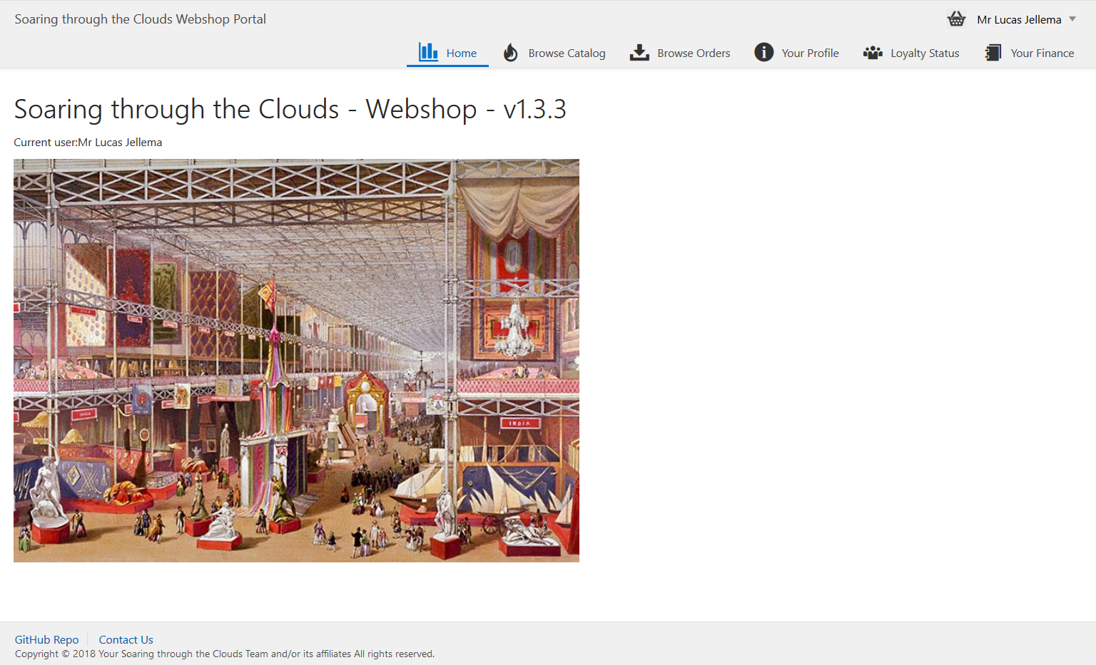
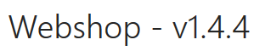
Meet Our Web Shop
Notes:
start with a demo of the Webshop - from customers signs and browses the products catalog to check out of the shopping basket, composing the order with delivery details and submitting the order; then checking the invoices and perhaps making the payment, reviewing the loyalty points and status and finally checking on the order progress (as the order gets picked, shipped and finally delivered).

Slide 35
What’s the IT behind the Webshop?
Web Shop Portal
µ Customers
µ Orders
µ Products
µ Loyalty
µ Finance
µ Logistics
µ Customers
µ Orders
µ Products
µ Loyalty
µ Finance
Notes:
dazzle the audience with a quick dump of all technologies (and cloud services) used for putting the webshop together - for the UI, the API implementation, the datastores and the event bus.

Slide 36





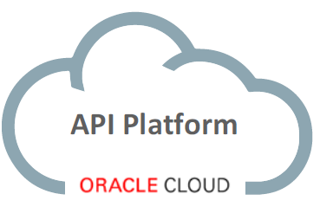
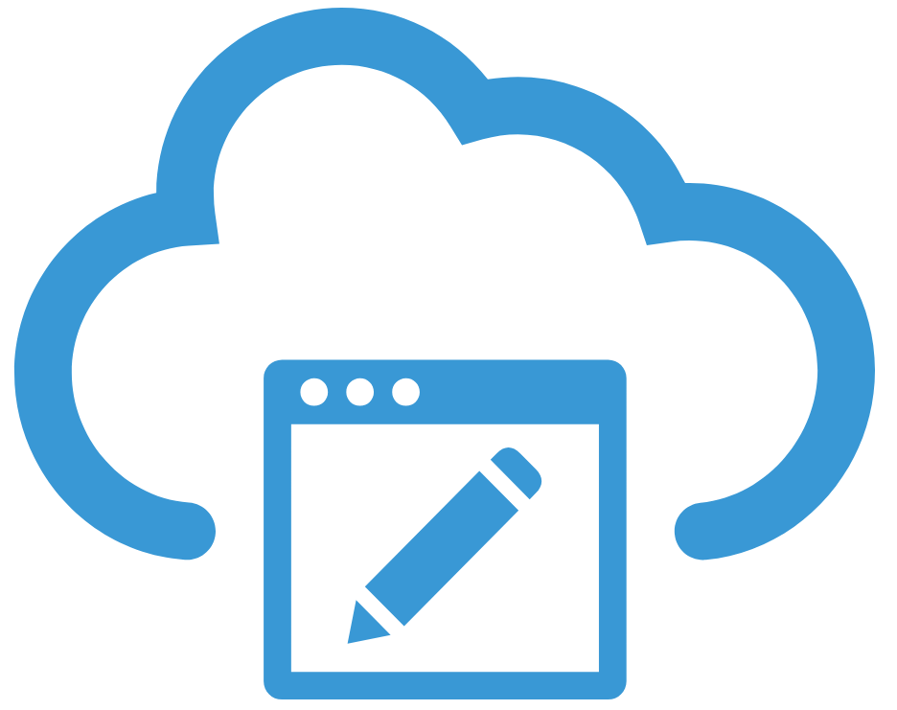


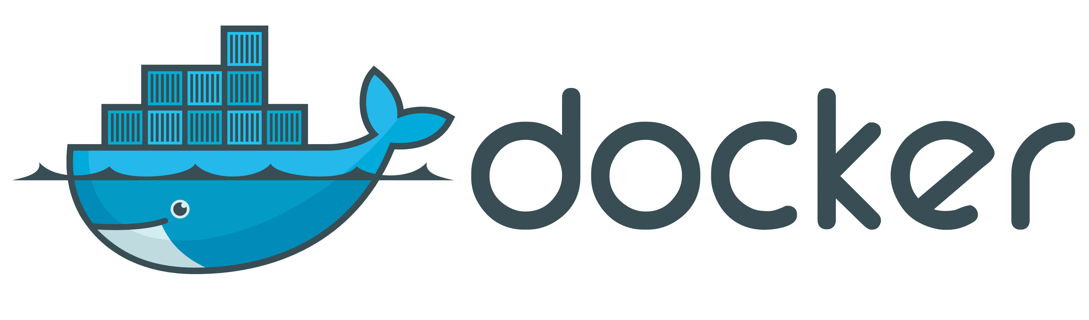
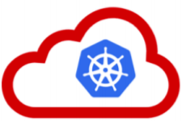






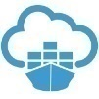




API Portal
Web Shop Portal
µ Customers
µ Orders
µ Products
µ Loyalty
µ Finance
API Platform
Backoffice UI
λ
Event Schema Registry
Event Hub
Notes:
dazzle the audience with a quick dump of all technologies (and cloud services) used for putting the webshop together - for the UI, the API implementation, the datastores and the event bus.

Slide 37
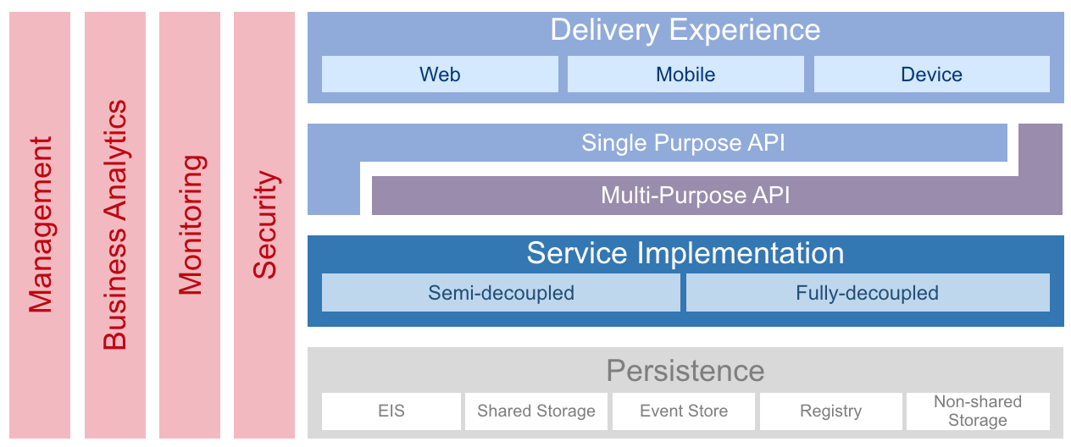
Architectural foundation: OMESA
http://omesa.io

Slide 38
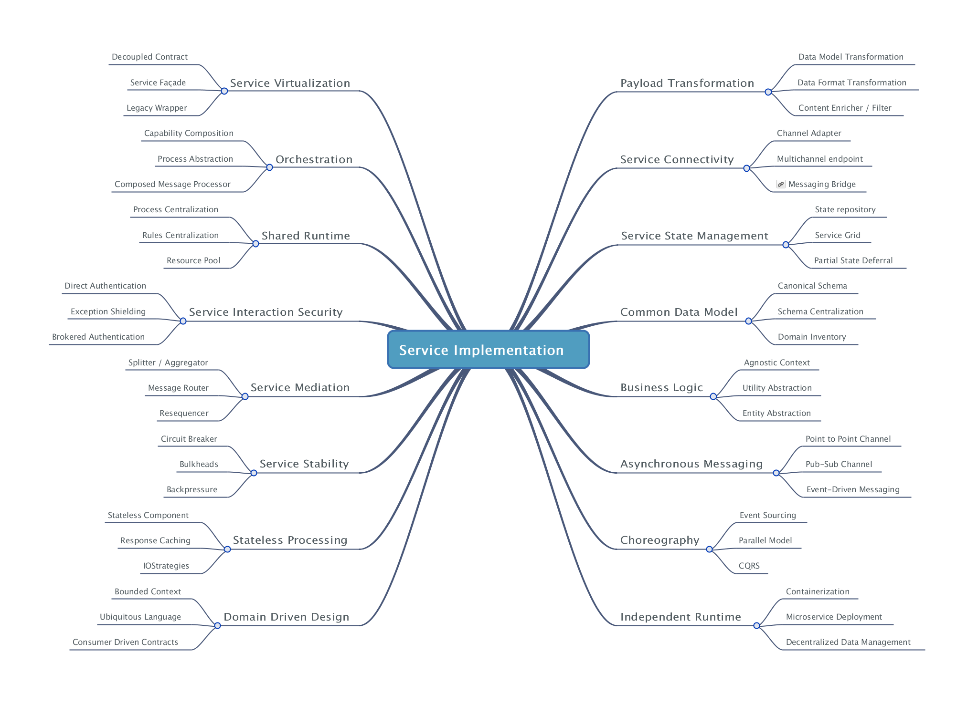
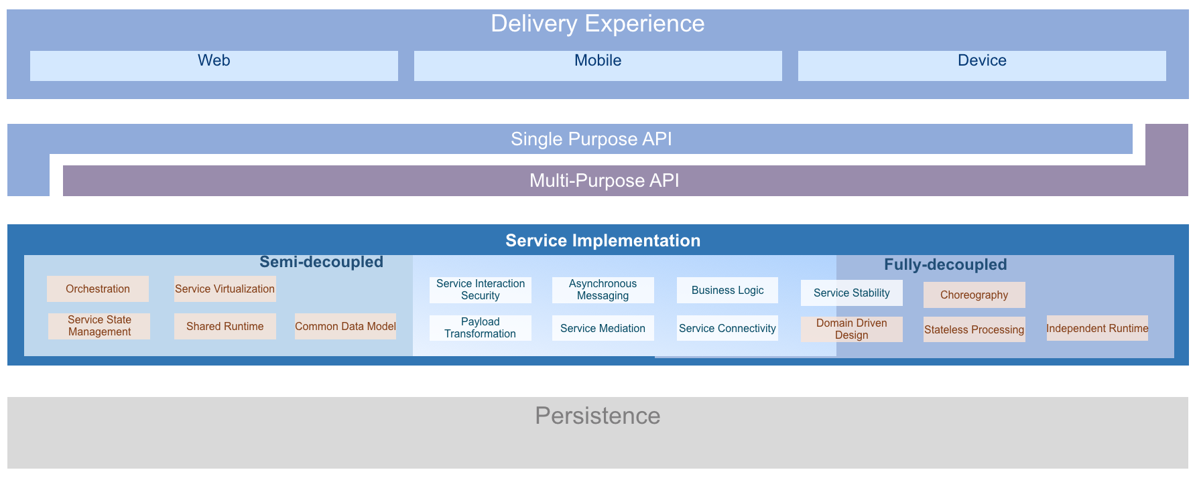
OMESA - Capabilities and patterns
http://omesa.io

Slide 39
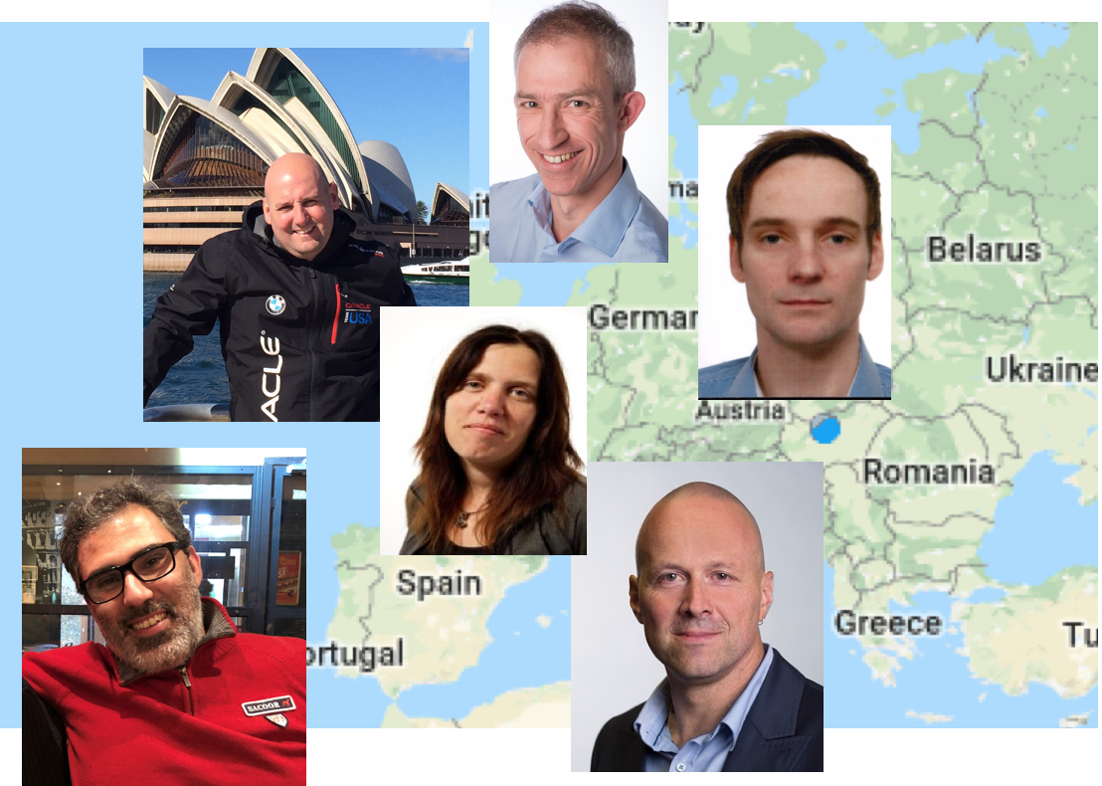
Why did we choose a µServices Architecture?
Good fit for our use case
Flexibility: Comprehensible, maintainable, independently releasable
Scalable
Fault tolerant & robust
Benefit from technological innovation (without enterprise risk & impact)
Decoupled development
Acurate need for coordination
Async, on-demand communication
Dedicated responsibility and ownership
Flexibility and different skill sets
Technologies
Platforms

Slide 40
Microservices Architecture Design & Implementation Characteristics (12-factor)
Are encapsulated and stand-alone
Stateless and horizontally scalable
Offer REST APIs
Expose configurable properties – such as endpoints of dependencies
Are released & deployed & scaled independent of each other
They can be co-located but they do not have to
Continuous Delivery – including automated build and test – are applied
Publish events and consume (relevant) events from central event bus
Are responsible for their own data
take care of persistence in a fitting data store
Also manage the bounded context: data owned by/derived from other microservices that the service requires to function independently and at speed
Even though not required, containers are a popular vehicle for build, ship and run
Kubernetes is becoming the de facto standard container management runtime platform
Notes:
spend a little time on microservices - why decided to apply a microservices architecture (objectives, expectations) and how we designed the architecture in our case (link to Omesa?). What were the rules and assumptions. Here we can perhaps show how we use Slack and GitHubExplain in some details what important role events played. Maybe at that point also discuss the workflow (@Luis Weir’s article and our discussions around that).Perhaps we can use the Event Monitor Dashboard (that shows all on EventHub/Kafka events on a timeline ) to illustrate the story on the events (and the Order workflow)

Slide 41
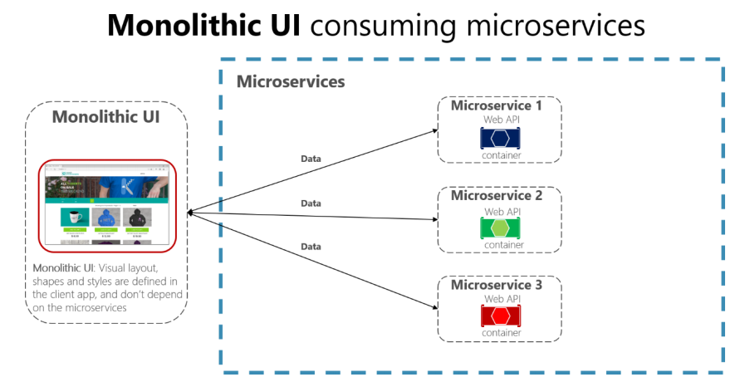
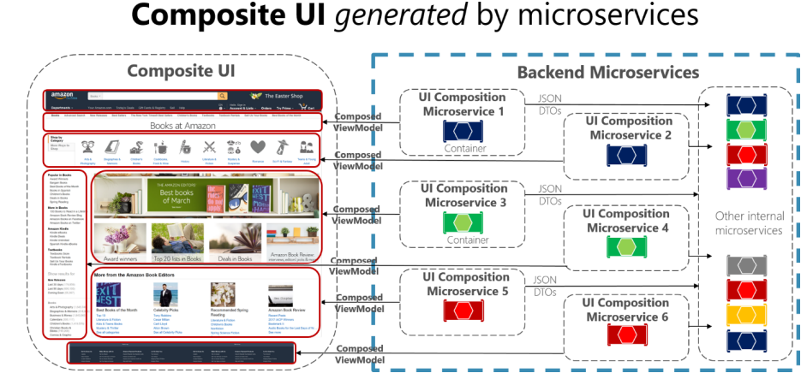
Microservices Architecture User Interface
Is UI part of Microservice?
VS.
Notes:
spend a little time on microservices - why decided to apply a microservices architecture (objectives, expectations) and how we designed the architecture in our case (link to Omesa?). What were the rules and assumptions. Here we can perhaps show how we use Slack and GitHubExplain in some details what important role events played. Maybe at that point also discuss the workflow (@Luis Weir’s article and our discussions around that).Perhaps we can use the Event Monitor Dashboard (that shows all on EventHub/Kafka events on a timeline ) to illustrate the story on the events (and the Order workflow)

Slide 42
User Interface in a Microservices architecture
Web Shop Portal
µ Customers
µ Orders
µ Products
µ Loyalty
µ Finance
µ Logistics
µ Customers
µ Orders
µ Products
µ Loyalty
µ Finance

Slide 43
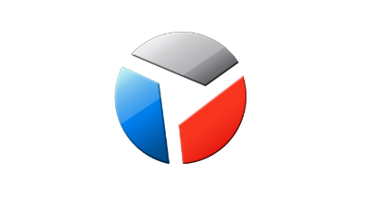
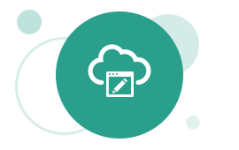

Web Shop Portal Solution Design – decoupled IFRAME based microservice front-ends
Web Shop – Customer User Interface
CustomerSignIn,
ChangedProfileSettings
Client Side (JS) Event Bus & Routing
Context (user settings, navigation history, ..)
Menu & Nav
Marketing content
IFRAME
IFRAME
ViewProduct
InspectInvoice
IFRAME
IFRAME
IFRAME
AddToBasket
API Gateway
µ Customers
µ Orders
µ Products
µ Loyalty
µ Billing & Invoicing

Slide 44
Microservices Architecture Organizational aspects
Doing Microservices seriously, implies change!
Dedicated responsibility throughout a Microservices lifecycle
Breakthrough the traditional borders between Dev and Ops guys
One have to come out of the own comfort zone
Starting a Microservice initiative means a improved need for communication, because of
API definitions
Events and interactions
Defining Bounded contexts is not straight-forward and might conflict with organizational aspects

Slide 45









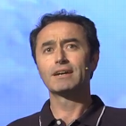

Ways of Working – A Multi Team Effort
Web Shop Portal
µ Customers
µ Orders
µ Products
µ Loyalty
µ Finance
Notes:
dazzle the audience with a quick dump of all technologies (and cloud services) used for putting the webshop together - for the UI, the API implementation, the datastores and the event bus.

Slide 46
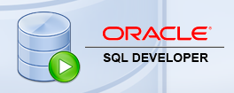
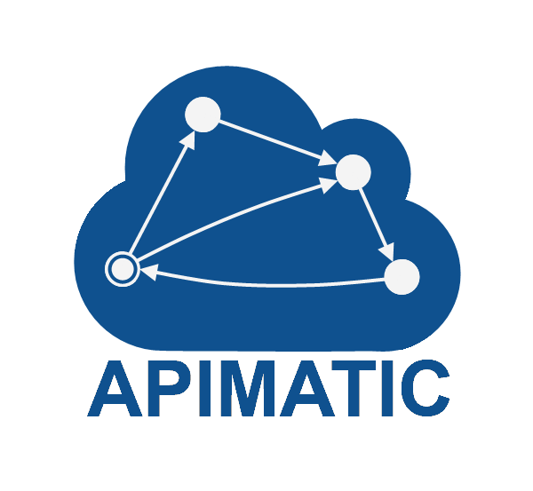



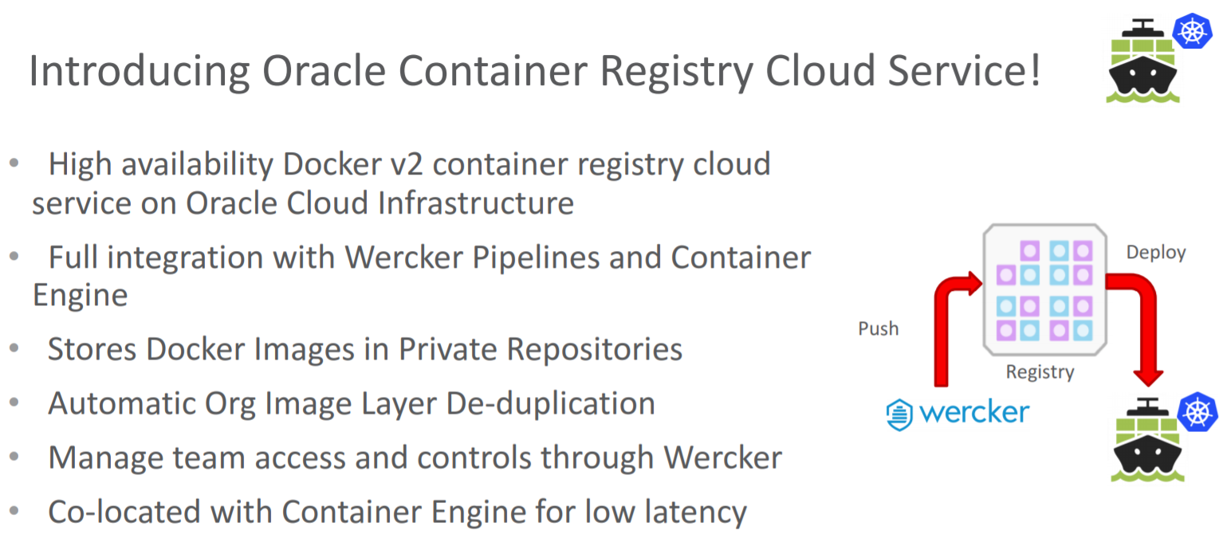





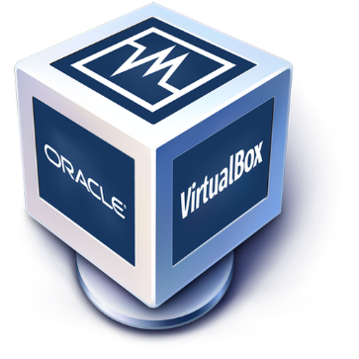

Toolbox

Slide 47
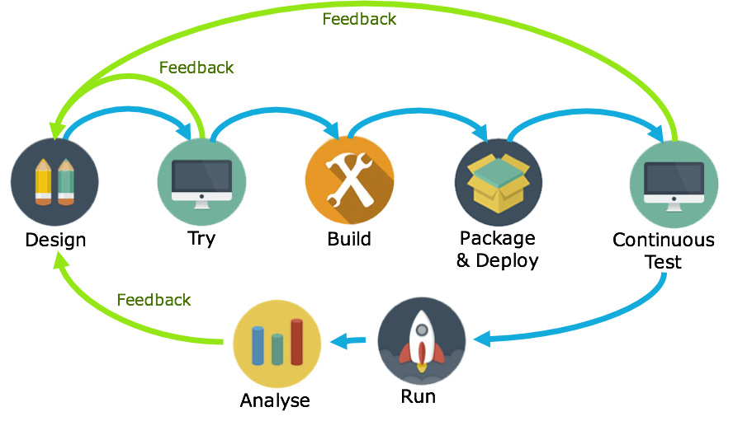
API-First
1
Avoid rework: feedback early in the cycle
By getting feedback very early in the lifecycle, changes of rework late in the cycle are slim. Saving time and cost.
2
Parallel development: Decouple App dev from Service dev
By defining APIs with API Blueprints or Swagger, app dev and service dev can occur in parallel.
3
Agile: be ready for change
By continuously verifying service builds against API definitions, non-compliant updates can be detected quickly.

Slide 48
API Gateway
Many other consumers
API Portal
Web Shop Portal
µ Customers
µ Orders
µ Products
µ Loyalty
µ Finance
API Platform
Routing & Load Balancing
Authentication/Authorization
Policy Enforcement
IP Black & White-listing
Throttling, Circuit Breaking
Protocol Translation (& light weight conversion)
Analytics
Billing

Slide 49
API First? Hey wait, can’t we do better?
Shop Microservice
Order Microservice
{ }
Call PlaceOrderAPI
UI
Logic
API
Logic
State
Call UpdateStockAPI
Stock Microservice
sync request/response
{ }
async, event pub/sub
async request/response
State
API
Logic

Slide 50

…. Event-(First) Driven
Event Monitor
Product Update
Product added to Shopping Cart
Shop
Products
Oracle Event Hub Cloud Service (Managed Kafka)
Topic X
Topic Y
Topic Z
Topic Q
New Customer
Customer Profile Changed
Customer Sign In
Customers
Order Payment Received
Customer Frozen
Customer Loyalty Status Change
Order Create
Order Cancelled
Product Stock Update
Shipping News
Loyalty Program
Order
Logistics
Finance

Slide 51
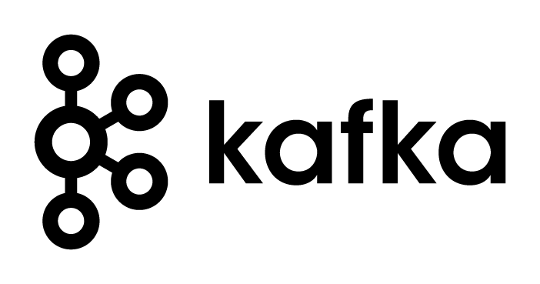
Apache Kafka is the Event Hub
Consumers
Producers
Robust, Scalable, Fast, History Retention
Containerized/ Cloud-enabled
Open

Slide 52

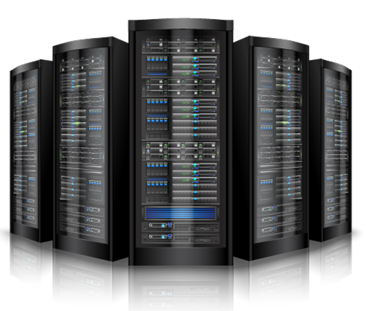

The “Twitter for System Driven Event Interaction”
≈
Decoupled communication – organized per topic
0, 1 or many Consumers per Topic
Scalable number of messages (and parties)
Reliable (distributed)
Full history
Open: libraries in many technologie & REST APIs
Near real-time fast
No Rate Limit
No enforced size limit
Anything goes (it’s all byte[])
On premises or in cloud, private or trusted
Very much for programmatic use

Slide 53
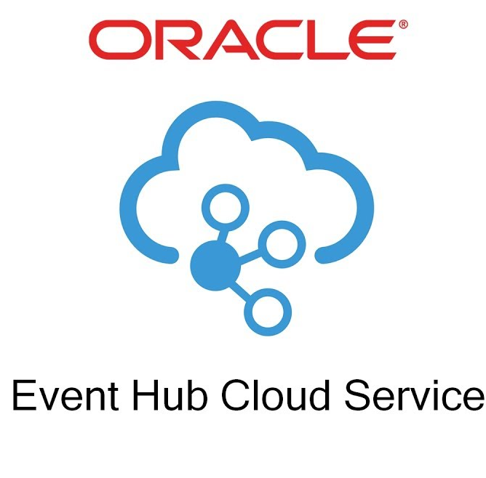
Oracle embracing Apache Kafka
Event Hub Cloud Service = Managed Apache Kafka platform
Managed Topics have been announced too
Oracle Cloud Infrastructure: Telemetry & Streaming
Read from Kafka Topic in Oracle Database SQL queries
And publish to Kafka Topic from Oracle Database PL/SQL

Slide 54

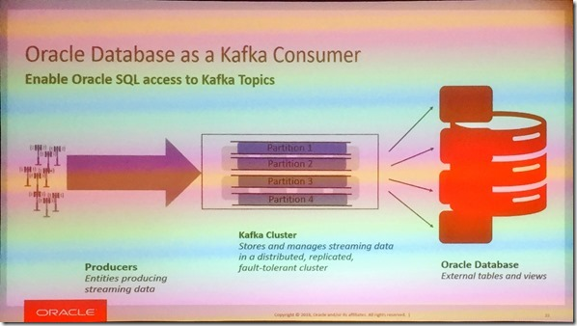
SQL on Kafka in Oracle Database
Oracle Database works with Kafka Topics as “external table”
Publishing from Oracle Database to a Kafka Topic is on the roadmap for v2
Announced at OOW 2018, planned for Spring 2019

Slide 55
Oracle embracing Apache Kafka
Event Hub Cloud Service = Managed Apache Kafka platform
Managed Topics have been announced too
Oracle Cloud Infrastructure: Telemetry & Streaming
Read from Kafka Topic in Oracle Database SQL queries
And publish to Kafka Topic from Oracle Database PL/SQL
Kafka as source for Data Integration Platform (Golden Gate and ODI)
Data Pipeline with Data Hub (Apache Cassandra) & Event Hub
Oracle Service Bus Kafka Adapter
Integration Cloud
Stream Analytics (aka Stream Explorer fka Oracle Event Processor)
Oracle Native Container and Microservices Platform
Fn Serverless Platform – triggered by and publishing to
Visual Builder & JET - real time push based on Apache Kafka
In general – the bridge between on premises ⬄ [public] Cloud

Slide 56
API-Design First
1
Avoid rework: feedback early in the cycle
By getting feedback very early in the lifecycle, changes of rework late in the cycle are slim. Saving time and cost.
2
Parallel development: Decouple App dev from Service dev
By defining APIs with API Blueprints or Swagger, app dev and service dev can occur in parallel.
3
Agile: be ready for change
By continuously verifying service builds against API definitions, non-compliant updates can be detected quickly.

Slide 57
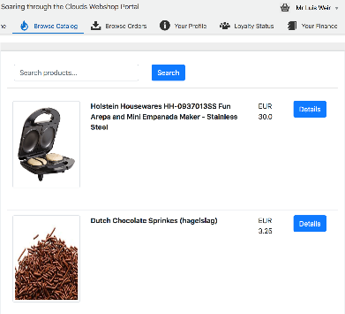
Orders Microservice
1
Items are added to shopping basket. Product MS adds items to topic “add-to-shopping-cart”.
Based on MEON (Mongo, Express, Oracle JET, Node.JS)
Oracle
Kubernetes
Engine (OKE)
(AD1) Container
AD2
AD = Availability Domains
2
AD3
”Product Subscriber Service” receives the items added. Then based on the Customer ID, checks if a Shopping Cart exists. If yes, adds the items to the basket. If no, creates a new Shopping Cart and then adds the item. This verifications occur by calling Orders Service via HTTP binding (but using K8s Service Name).
Orders
UI
3
API Gateway
Oracle API Platform Cloud Service
Ingress LB
3
A user initiates the checkout process. During the process, the UI interacts with not just Orders MS API, but other APIs such as Customer (for getting the Customer Details, and Logistics for checking stock availability and shipping price.
Container
HTTP Binding
(K8S DNS)
Container
HTTP Binding
(K8S DNS)
Container
API Gateway
Product
Subscriber
Service
Order
Producer
Service
Orders
2
4
Customer
Logistics
Container
Mongo
4
Once the checkout process completes, an assuming that all details of the Order are verified, then the Order changes status to “SUCCESS” and and event is added to topic “order-created”.
Logistics
Event Hub CS
Loyalty
1
5
Logistics, Finance and Loyalty MS pick up the event for further processing.
Finance
5

Slide 58



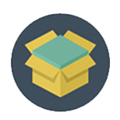







The process looks something like this
Feedback
Feedback
Design
Try
Build
Package & Deploy
Continuous Test
01
02
03
04
05
Create API Blueprint/OAS in Apiary
Use Apiary Mock endpoints to publish an API through the Oracle API platform
API docs and mock endpoints available in the Dev Portal
JET designers/developers try the API and give feedback
Build backend service using tech of choice
Use Dredd to test endpoints against spec
Switch API Gateway routing against tested endpoints
Stablish a CICD pipeline for continuously and consistently packaging and deploying releases, e.g. using Wercker
Set up functional regression testing (e.g. using API Fortress or Postman) to ensure UI functionality doesn’t break due to API changes.
Oracle API Platform
Notes:
curl -X GET http://127.0.0.1:3000
docker exec -it 28f812bf8902 bash register.sh d2VibG9naWM6SUszQVcxbjU= https://oc-144-21-66-168.compute.oraclecloud.com:7202/apiplatform/management/v1/services http://oc-144-21-66-168.compute.oraclecloud.com:3000/orders
Administration: http://docs.oracle.com/en/cloud/paas/api-platform-cloud/apfrm/index.html
Management: http://docs.oracle.com/en/cloud/paas/api-platform-cloud/apfrm/index.html
Developer Portal: http://docs.oracle.com/en/cloud/paas/api-platform-cloud/apfrd/index.html
Gateway controller (not working…): http://docs.oracle.com/en/cloud/paas/api-platform-cloud/apfrg/index.html
Analytics: http://docs.oracle.com/en/cloud/paas/api-platform-cloud/apfra/index.html
Instance lifecycle management: http://docs.oracle.com/en/cloud/paas/api-platform-cloud/apfrl/index.html

Slide 59


Cross Microservices Workflow
Choreography vs Orchestration – Which one is which?

Slide 60
Orchestration
Choreography
Store Web App
Store Web App
API Gateway
API Gateway
Process Engine
µService
Orchestrated Process
Receive Details
Credit Check
Process
Credit
Process
Credit
Receive Details
Check Credit Score
Good?
Yes
Reject
No
Process
Service
Event Hub
Credit Check
Process
Credit
Credit Check Event
Credit Check
Success
Credit Check
Failed

Slide 61

Microservices State
Generic Platform for running microservices
LDAP
Big Data
Block Storage
Cache
RDBMS
NoSQL
Document Store
Event Hub
Notes:
All data stores are distributed
Or at least distributedly available
They can be local or on cloud (latency is important)
Data in generic data store is still owned by only one microservice – no one can touch it
Only in DWH and BigData do we deliberately take copies of data and disown them

Slide 62
Bounded context in microservices
A micoservice needs to be able to run independently
It needs to contain & own all data required to run
It cannot depend on other microservices
UI
API
Customer
API
Order
CustomerModified event

Slide 63

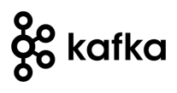




Demo – Maintaining Derived Data in Bounded Context
Customer Microservice
Order Microservice
Customer Modified Event
Application Container
Application Container
Event Hub
Customers
Topic
DBaaS

Slide 64
How? Run & Operate

Slide 65
Run & Operate Microservices
µ
µ
µ
µ
µ
Rapid rollout
Including scale out & recover
Non breaking upgrade & rollback strategies (e.g. canary release)
Agile infrastructure
Relocate, independent of infra specifics
Health management
Monitor and safeguard SLA requirements on response time, success and availability
Scale elastically
TCO management
DevOps: one team creates and runs
Generic Infrastructure Platform for running DevOps Products

Slide 66



The elephant in the room…
whale

Slide 67
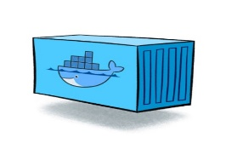
Containers
As vehicle for:
Encapsulate
Build
Share & Ship
Automated Tests
Deploy
Run
Scale
Relocate
Standardize

Slide 68
Looking for a runtime platform for
Compute Node
Notes:
Deploy and Run (Docker Containers)
Distributed infrastructure (scalable and available)
Hide infrastructure from DevOps teams
Auto-healing
Elastic Scale
Wire up the micros – connect dynamically (service discovery)
Load Balance
Provide Persistent storage
Rolling Upgrade
Configuration & Secret Management
Secure

Slide 69
Looking for a runtime platform for
Compute Node
Compute Node
Compute Node
Notes:
Deploy and Run (Docker Containers)
Distributed infrastructure (scalable and available)
Hide infrastructure from DevOps teams
Auto-healing
Elastic Scale
Wire up the micros – connect dynamically (service discovery)
Load Balance
Provide Persistent storage
Rolling Upgrade
Configuration & Secret Management
Secure

Slide 70
Looking for a runtime platform for
Compute Node
Compute Node
Compute Node
Notes:
Deploy and Run (Docker Containers)
Distributed infrastructure (scalable and available)
Hide infrastructure from DevOps teams
Auto-healing
Elastic Scale
Wire up the micros – connect dynamically (service discovery)
Load Balance
Provide Persistent storage
Rolling Upgrade
Configuration & Secret Management
Secure

Slide 71
Looking for a runtime platform for
Compute Node
Compute Node
Compute Node

Slide 72
Looking for a runtime platform for
Compute Node
Compute Node
Compute Node

Slide 73
Looking for a runtime platform for
Compute Node
Compute Node
Compute Node
Cloud Storage
SAN

Slide 74
Looking for a runtime platform for
Configuration Map
Configuration Map
Compute Node
Compute Node
Compute Node
Cloud Storage
SAN

Slide 75

Looking for a runtime platform for
Compute Node
Compute Node
Compute Node

Slide 76
Looking for a runtime platform for
Compute Node
Compute Node
Compute Node
Compute Node
Compute Node

Slide 77
Looking for a runtime platform for
Compute Node
Compute Node
Compute Node

Slide 78
Looking for a runtime platform for
v2
v2
v2
Compute Node
v2
v2
Compute Node
Compute Node

Slide 79
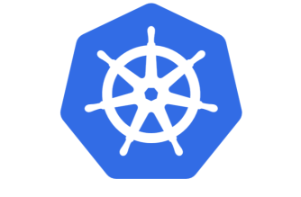

Slide 80
Introducing Kubernetes
Distributed Container Run Time Management platform
Based on Google’s Borg system (in use at Google for over a decade)
Initial announcement: 2014
Kubernetes v1.0 was released on July 21, 2015
A Kubernetes cluster typically spans multiple compute nodes
Either in the cloud, on premises, on a single machine (minikube) or hybrid
K8S manages Pods in which containers are running
K8S schedules Pods on one or more nodes
Docker can be the container runtime; other engines are supported as well, such as rkt and containerd
K8S handles network traffic to, between and from Pods
The kubectl command line interface is used for most management activities

Slide 81
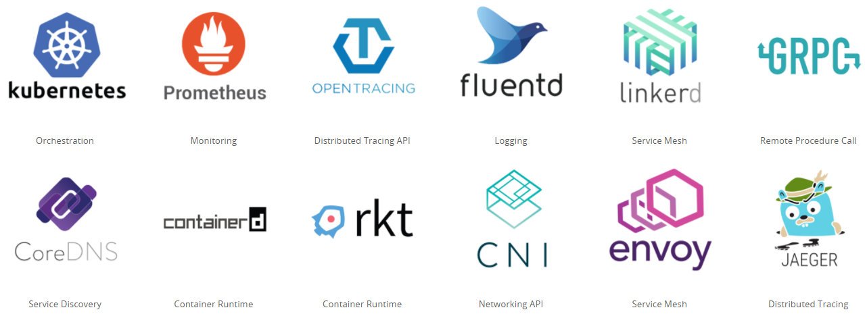
Cloud Native & Vendor Neutral
Cloud Native Computing Foundation - CNCF
Oracle is a platinum member since July 2017
Cloud Native: container packaged, dynamically managed, microservices oriented
Open technology for running container based workloads in a cross cloud vendor neutral way
Notes:
https://www.cncf.io/

Slide 82
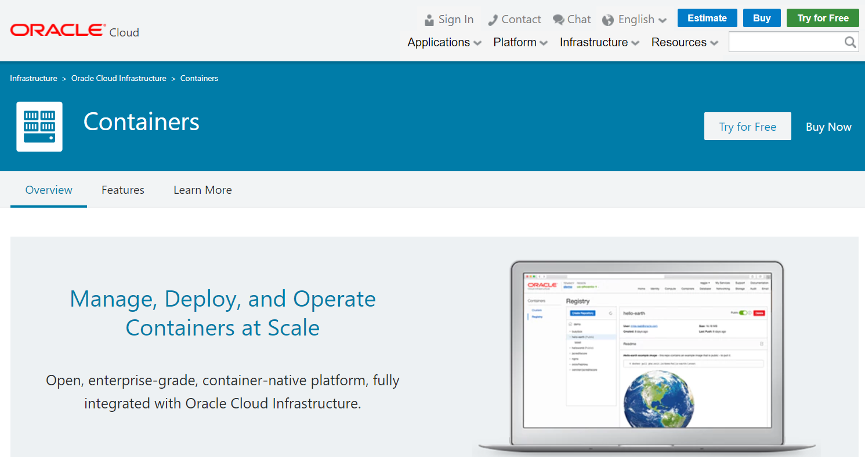
OKE – Oracle Kubernetes Engine (launched May 2018)

Slide 83
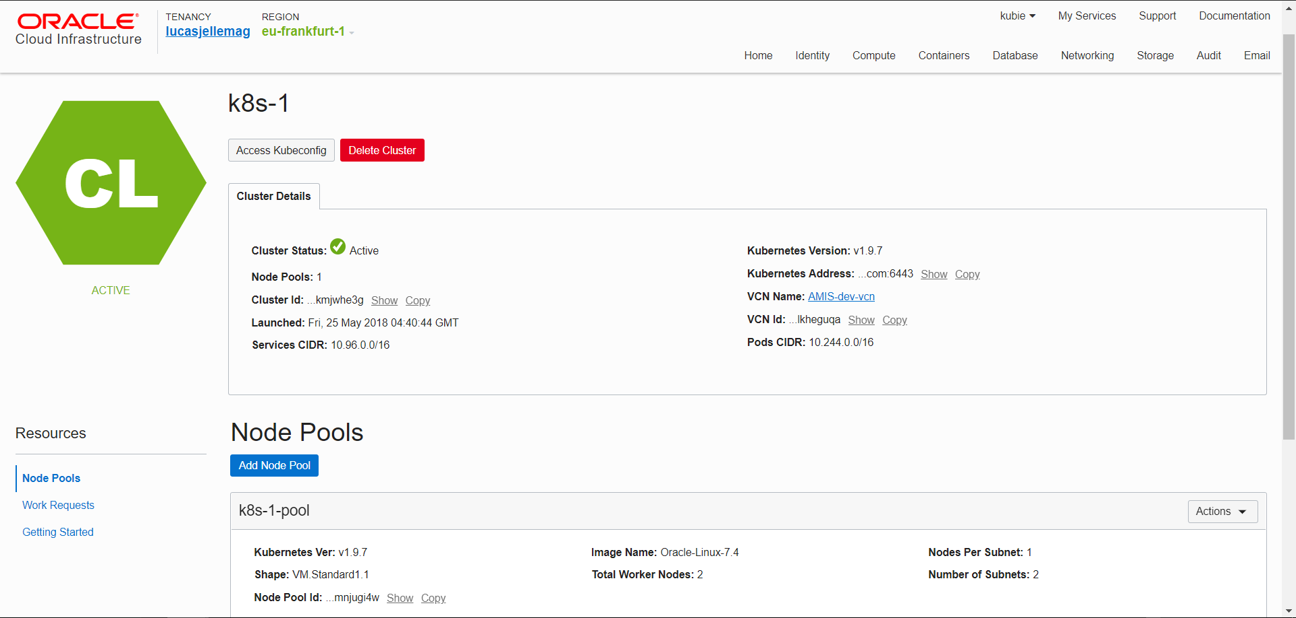

Slide 84
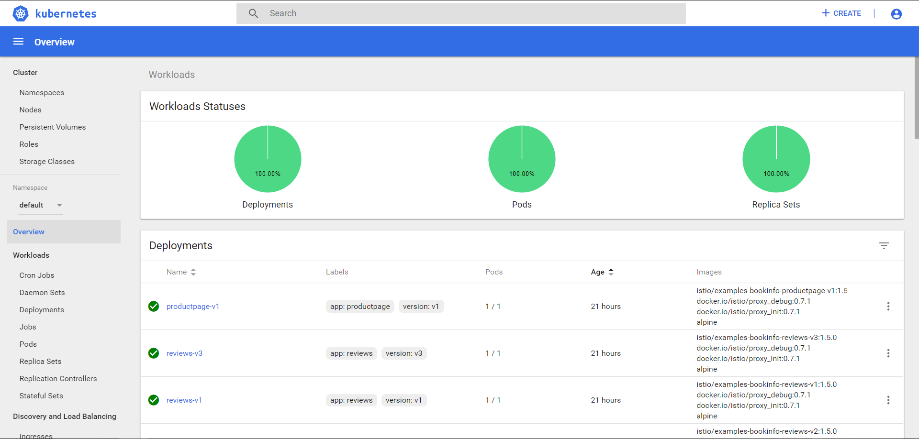

Slide 85
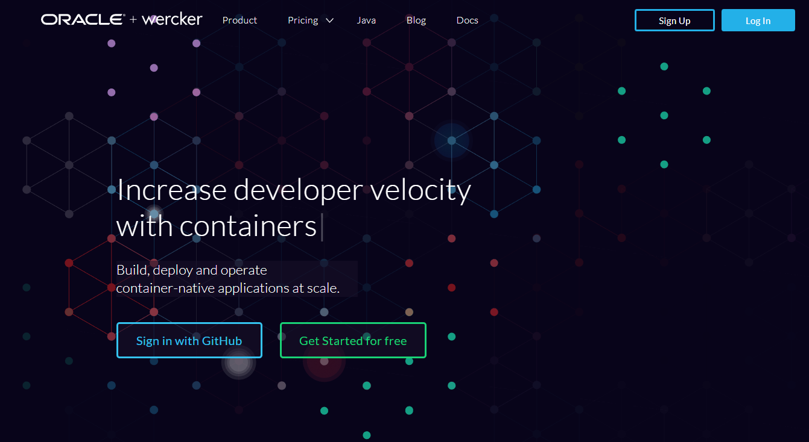
Automated Container [Build | Stock | Deliver] Pipelines
Oracle Wercker [aka Oracle Container Pipelines Cloud]

Slide 86
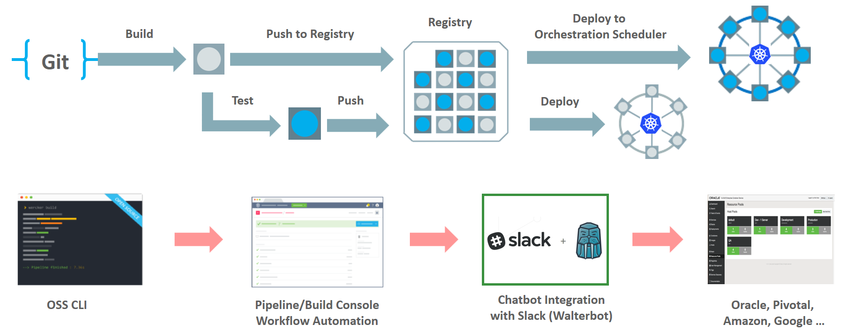
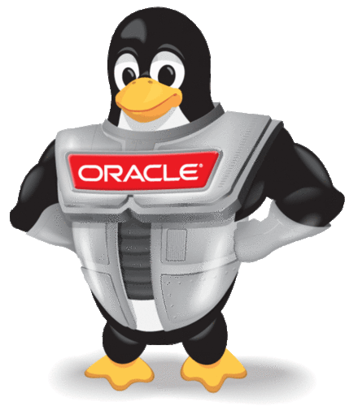
Wercker: Build, Test, Push and Deploy Pipelines for Containers
µ
µ
µ

Slide 87
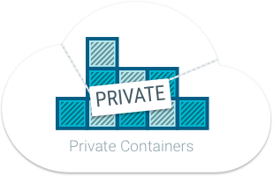
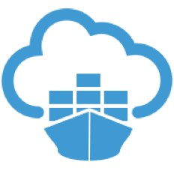

Oracle Container Registry for Your Images
After build and before run – container images need to be stored
Secure (because runtime artefacts)
Accessible (& low latency) to deployment engine and container runtime
Scalable and Smart (no duplicate images and image layers)
Notes:
https://docs.us-phoenix-1.oraclecloud.com/Content/Registry/Concepts/registryoverview.htm?Highlight=registry

Slide 88
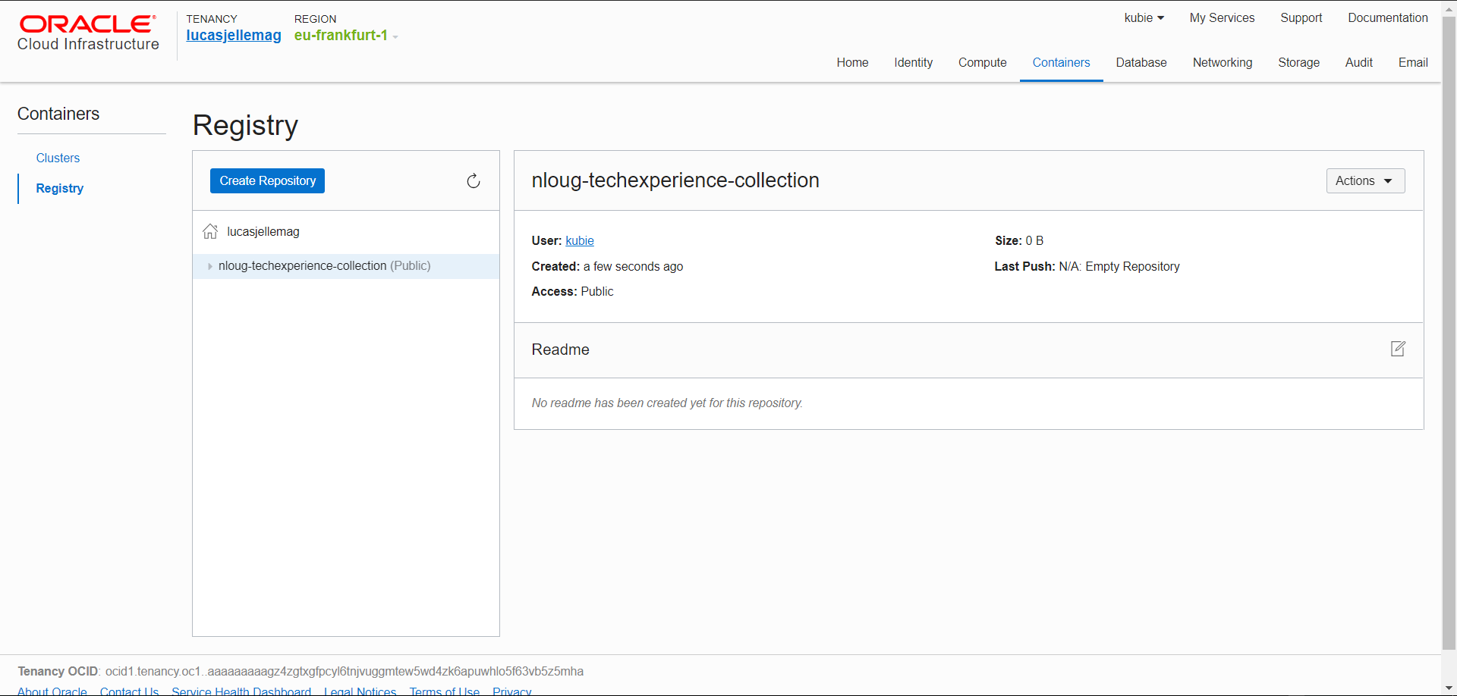

Slide 89

Roadmap Oracle OpenWorld & CodeOne
Notes:
Fast data arrives in real time and potentially high volume. Rapid processing, filtering and aggregation is required to ensure timely reaction and actual information in user interfaces. Doing so is a challenge, make this happen in a scalable and reliable fashion is even more interesting. This session introduces Apache Kafka as the scalable event bus that takes care of the events as they flow in and Kafka Streams and KSQL for the streaming analytics. Both Java and Node applications are demonstrated that interact with Kafka and leverage Server Sent Events and WebSocket channels to update the Web UI in real time. User activity performed by the audience in the Web UI is processed by the Kafka powered back end and results in live updates on all clients.
Fast data arrives in real time and potentially high volume. Rapid processing, filtering and aggregation is required to ensure timely reaction and actual information in user interfaces. Doing so is a challenge, make this happen in a scalable and reliable fashion is even more interesting. This session introduces Apache Kafka as the scalable event bus that takes care of the events as they flow in and Kafka Streams for the streaming analytics. Both Java and Node applications are demonstrated that interact with Kafka and leverage Server Sent Events and WebSocket channels to update the Web UI in real time. User activity performed by the audience in the Web UI is processed by the Kafka powered back end and results in live updates on all clients. Introducing the challenge: fast data, scalable and decoupled event handling, streaming analytics Introduction of Kafka demo of Producing to and consuming from Kafka in Java and Nodejs clients Intro Kafka Stream API for streaming analytics Demo streaming analytics from java client Intro of web ui: HTML 5, WebSocket channel and SSE listener Demo of Push from server to Web UI - in general End to end flow: - IFTTT picks up Tweets and pushed them to an API that hands them to Kafka Topic. - The Java application Consumes these events, performs Streaming Analytics (grouped by hashtag and author and time window) and counts them; the aggregation results are produced to Kafka - The NodeJS application consumes these aggregation results and pushes them to Web UI - The WebUI displays the selected Tweets along with the aggregation results - in the Web UI, users can LIKE and RATE the tweets; each like or rating is sent to the server and produced to Kafka; these events are processed too through Stream Analytics and result in updated Like counts and Average Rating results; these are then pushed to all clients; this means that the audience can Tweet, see the tweet appear in the web ui on their own device, rate & like and see the ratings and like count update in real time

Slide 90

Intro Movie
OCI Intro
Notes:
https://www.oracle.com/openworld/on-demand.html?bcid=5853119603001 – 20 seconds?

Slide 91

Forms ADF JET … what’s next?
Custom Application Development
Custom App Development

Slide 92

Roadmap for Managed Microservices Infrastructure: Containers Kubernetes Functions
Microservices Platform
Containers, Microservices, Functions

Slide 93
Lessons Learned
An Architect has to be a Developer
Communication is essential – even if only about the touching points such as Events & APIs
Events are the backbone that allow decoupled interaction between independent microservices
EventHub CS (Apache Kafka) is the crucial backbone of our enterprise landscape
We need a more effective way to model choreographies. Who produces events, who consumes events, and chain of events. Both at design time and runtime
UI skillset is not same as backend service/API skills set. We can’t assume that everyone that’s a backend/API developer will want to learn UI skills.
Learning Kubernetes is absolutely required
Automating delivery of microservices is crucial
Fail fast, expect frequent failure of environments, introduce chaos deliberately (to learn how to deal with it)

Slide 94
Lessons Learned (page 2 / many)
Make sure all configuration settings (endpoints etc) are injected at deployment time and are NOT HARD CODED
To ensure scalability and quick redeploy and fail over, it is adamant that microservices are stateless
Data Bound(ed) Context makes Microservices independent
Every Microservice stores all data it requires – based on events, for example: Logistics MS stores physical product details (weight, size)
Getting Node JS to work with Kafka AVRO is special
HTTP Headers can be tricky – CORS, Frame Busting, API-KEY and more
Not all instances of an Oracle Cloud Service are created equally
Depending on region, version, time of creation, data center, and other attributes
Git skills are essential!
For debugging and troubleshooting (across asynchronous interactions) we need good tooling to gain insight – design time and run time
Automated regression tests are extremely important
…

Slide 95






?

Slide 96
References
Github repositories
https://github.com/lucasjellema/soaring-through-the-cloud-native-sequel
https://github.com/lucasjellema/webshop-portal-soaring-through-the-cloud-native-sequel
https://github.com/lucasjellema/logistics-microservice-soaring-clouds-sequel
https://github.com/lucasjellema/webshop-customers-soaring-through-the-cloud-native-sequel
https://github.com/lucasjellema/soaring-avro-event-monitor
https://github.com/lucasjellema/webshop-products-soaring-through-the-cloud-native-sequel
https://github.com/lucasjellema/webshop-orders-soaring-through-the-cloud-native-sequel

Slide 97
References
Github repositories
https://github.com/luisw19/orders-microservice-soaring-clouds-sequel
https://github.com/gschmutz/infrastructure-soaring-clouds-sequel
https://github.com/gschmutz/metadata-soaring-clouds-sequel
https://github.com/svenbernhardt/financials-microservice-soaring-clouds-sequel
https://github.com/ldikmans/webshop-customers-soaring-through-the-cloud-native-sequel
https://github.com/ldikmans/customer-microservice-soaring-clouds-sequel
https://github.com/LinkRedCloud/loyaltyprogrammicroservice

Slide 98
Microservices Architecture
Microservices are not the silver bullet!
Important concepts:
Choreography (vs. Orchestration in classic SOA environments)
Bounded Context (Domain Driven Design)
DevOps: Teams taking ownership for Dev & Ops (”You built it, you run it!”)
But: Good fit for our use case, since increased
Flexibility: Comprehensible, maintainable, independently releasable
Scalable
Fault tolerant & robust
Benefit from technological innovation (without enterprise risk & impact)
Notes:
spend a little time on microservices - why decided to apply a microservices architecture (objectives, expectations) and how we designed the architecture in our case (link to Omesa?). What were the rules and assumptions. Here we can perhaps show how we use Slack and GitHubExplain in some details what important role events played. Maybe at that point also discuss the workflow (@Luis Weir’s article and our discussions around that).Perhaps we can use the Event Monitor Dashboard (that shows all on EventHub/Kafka events on a timeline ) to illustrate the story on the events (and the Order workflow)

Slide 99


Demo Part
Schema Registry with Avro
Producing and Consuming Events
Re-Consume all Product Events
Kibana Dashboard

Slide 100
Storing state: noSQL or SQL
SQL
noSQL
Predefined structure
Structured language
Table based
Vertical scalable
Best fit for multi row transactions
Dynamic structure
Hierarchical structure
Document, key-value, graph
Horizontally scalable
Best fit for large and/or ever changing data sets

Slide 101
Storing state: the container
Part of the container
Outside the container
One MS, one container
One MS, multiple container
Microservice
Microservice
{ }
{ }
State
State
Logic
API
Logic
API
But it is still part of the bounded context: don’t connect to it directly from another MS

Slide 102
Example
Schema
Saving
Hooks

Slide 103
Orchestration
Choreography
Store Web App
HTTP/JSON 200
{‘outcome’ = ‘processing’}
HTTP/JSON
Store Web App
Outcome
(Websocket, pushNot or Pull)
HTTP/JSON
HTTP/JSON 200
{‘outcome’ = ‘rejected’}
HTTP 202
Accepted
API Gateway
API Gateway
Process Engine
µService
Orchestrated Process
Receive Details
Credit Check
Process
Credit
Process
Credit
Receive Details
Check Credit Score
Good?
Yes
Reject
No
Process
Service
Event Hub
Credit Check
Process
Credit
Credit Check Event
Credit Check
Success
Credit Check
Failed

Slide 104



Slide 105


Slide 106


Slide 107


Rapid UI development using Next Gen VBCS leveraging the API change
Back Office UI for Logistics (built with VBCS against the REST APIs of the Logistics MS)
Objective: add a new page that shows all shippings that contain the selected product
Steps:
Create service connection for the new API Endpoint
Create a new page for shippings
Add table to page – based on the new API endpoint
Create button on Product Detail page to navigate to the new page
Run the application

Slide 108
Lessons Learned
An Architect has to be a Developer

Slide 109
Next steps – Business Functionality
Provide real time business [process] insight using Streaming Analytics (on the events)
Add advanced “search” capabilities in the UI – based on Elastic Search
Enhance User Experience
Machine learning powered product suggestions
Chatbot powered user interface
Send notifications to customers about order & shipping status updates
Orders History and Order Cancelling & Order Status Updates and Order Status History
Apply Loyalty Discount

Slide 110
Next steps – Architecture & Technology
Include TCO analysis
Consistently use AVRO event format throughout our services
Solve problems with API platform and add missing API implementations
Introduce a legacy or standard/SaaS application (and wrangle it)
For example an application for Product Configuration
Use Kubernetes as the generic deployment platform
Have a unified runtime platform for development – probably also based on Kubernetes (minikube)
Apply security – on APIs, on UI – authentication and authorization
How to do UI Mashup
Embrace Serverless

Slide 111
Next steps – Architecture & Technology
Do TCO analysis
Consistently use AVRO throughout our services
Solve problems with API platform and add missing API implementations
Introduce a legacy or standard/SaaS application (and wrangle it)
For example an application for Product Configuration
Use Kubernetes as the generic deployment platform
Have a unified runtime platform for development – probably also based on Kubernetes (minikube)
add management/monitoring to Kubernetes (e.g Istio, Zipkin, Grafana, Vizceral)
find a good solution for the workflow
add notification and push (server to client; server sent events & web sockets)
handle event production failure; handle historic event consumption
apply event sourcing?
strategy for splitting a microservice (for example break up Logistics MS into shipping and warehousing)
fully automated delivery pipelines for all components
automated regression testing of MS APIs
a way to test events (both production and consumption)
implement security - OAuth authentication, using IDCS for identity management, log in and authorization
have a central catalog for client events as well as enterprise events
embrace upcoming Oracle Container Engine Cloud
Build up a catalog of reusable components – such as JET composite components
Find a best approach for UI mash up
Embrace Serverless

Slide 112




Thank you!
Blog: technology.amis.nl
Email: lucas.jellema@amis.nl
: @lucasjellema
: lucas-jellema
: www.amis.nl, info@amis.nl
Notes:
Arigato-gozaimasta
Arigatōgozaimashita

